Slide 1


Active Learning
Time Management

Slide 2
Group Activity1: Self Paced Learning
Understand Active Learning

Slide 3
5 Aspects Of Learning
Perception
Observation
Inference
Newness
Traditional
POINT

Slide 4


1. Perception
Where does the Sun rise?
Where does the Sun set?
L1 - Sensory Knowledge

Slide 5
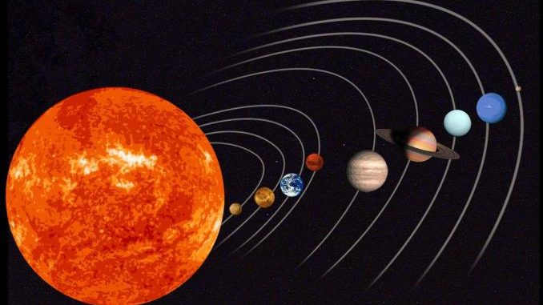
2. Observation
Why does the Sun rise in the East?
Why does the Sun set in the West?
Isn’t the Earth round?
How does the Solar System Work?
L2 - Intellect

Slide 6

3. Inference
What did you infer from the earlier observation?
It is the movement of Earth around the sun that causes this effect of Sunrise and Sunset.
Also the earth is rotating

Slide 7
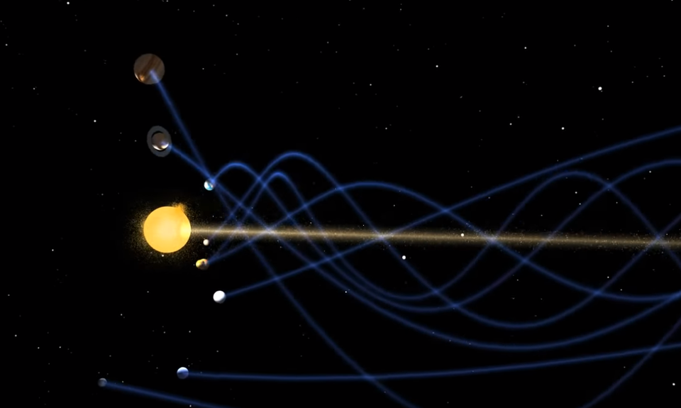
4. Newness
New is the vortex. Sun itself is travelling at 70000 km per hour and taking all the planets in its wake

Slide 8
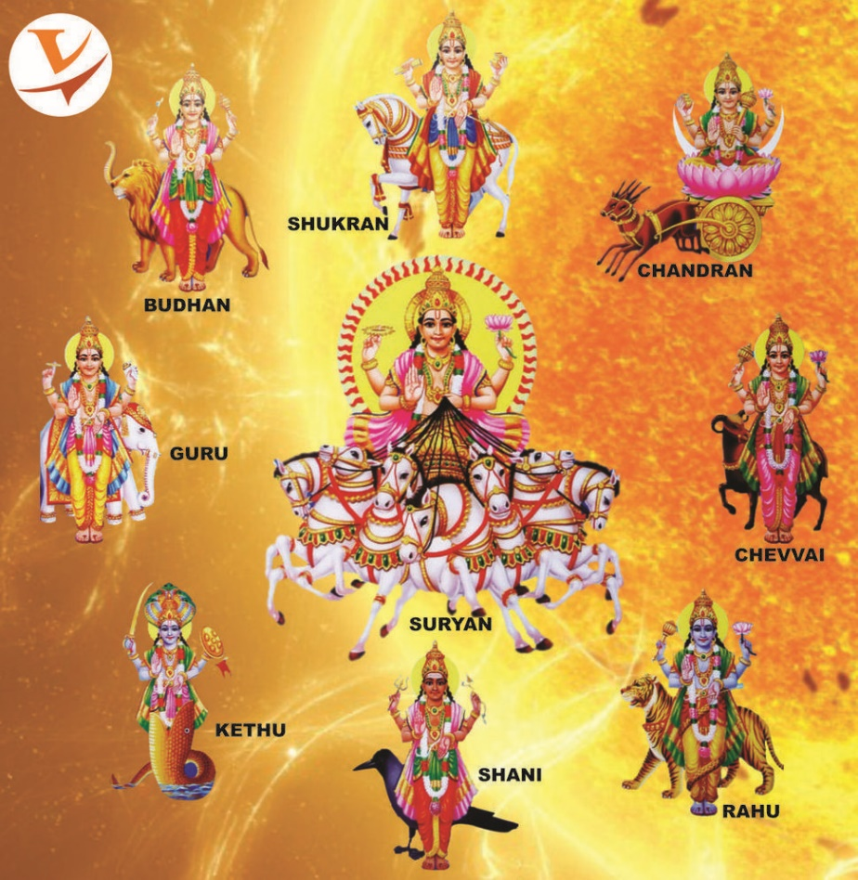
5. Traditional
How our temples have the Navagraha proving that they knew the planets revolved around the sun

Slide 9
POINT
PERCEPTION
  Existing Knowledge
  Sensory Knowledge
  It is usually not the truth
OBSERVATION
  Questions to arrive at the truth
  Have a Questioning mind
  Helps in developing Analytical thinking
INFERENCE
  Statement of Truth
NEWNESS
  Syllabus keeps getting outdated, but takes time for system to introduce new
  That should not stop you from learning what is NEW in every topic you are studying
TRADITIONAL
  Connection to old

Slide 10
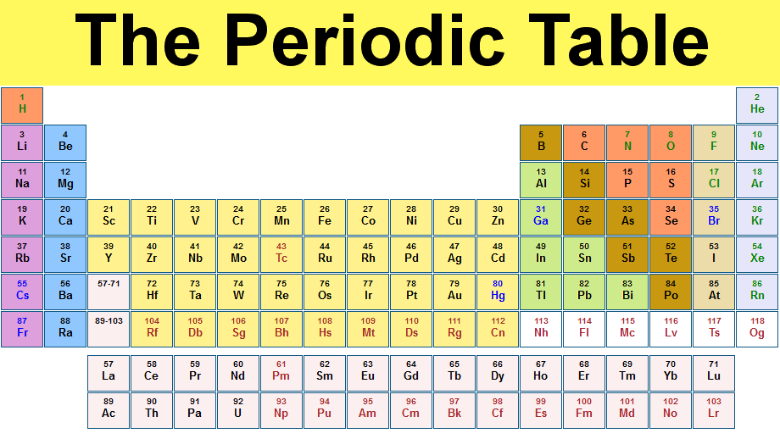
POINT Example 2

Slide 11
POINT
PERCEPTION
Table that groups all elements
OBSERVATION
What problems did Periodic table solved?
INFERENCE
  Conclusion of your truth
NEWNESS
Endangered Elements - Mobile phones contain numerous metals, including expensive ones. The most important are: copper, nickel, silver, gold, platinum group metals, cobalt, lithium, lead, tin, zinc, rare earth metals, gallium, indium, iron, chromium, niobium, tantalum, titanium.
TRADITIONAL
How were elements classified in ancient days?
Panchatava – Air, Water, Fire, Earth and Sky

Slide 12

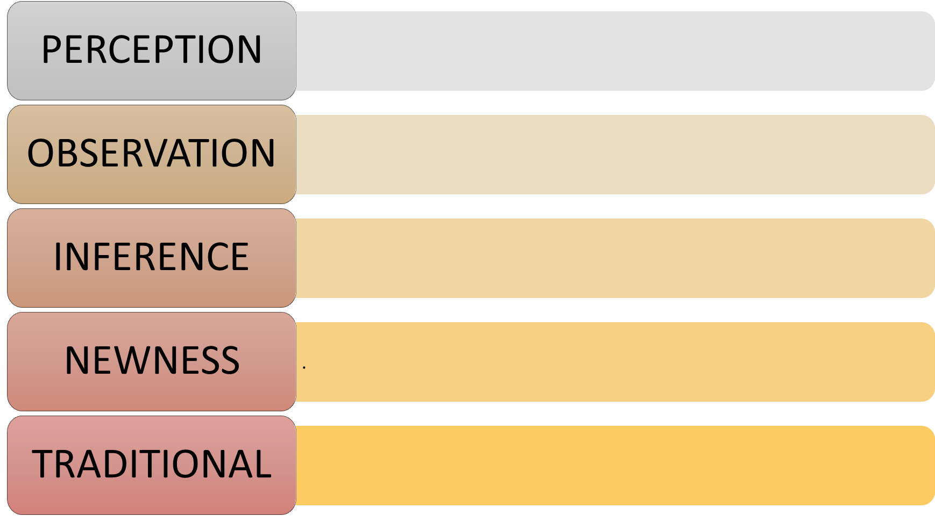
Group Activity2 – Practice POINT
Learn
Time management concept using
POINT Methodology

Slide 13
Time Management
Time management is the process of planning and exercising conscious control of time spent on specific activities, especially to increase effectiveness, efficiency, and productivity.
It involves a juggling act of various demands upon a person relating to work, social life, family, hobbies, personal interests and commitments with the finiteness of time.
Using time effectively gives the person "choice" on spending/managing activities at their own time and urgency.

Slide 14
Time Management Matrix
Urgent
Not Urgent
Quadrant I
Quadrant II
Important
Crises, projects,
accidents, etc.
Planning, exercise,
relationships, etc.
Tool to prioritize daily task
Quadrant III
Quadrant IV
Not
Important
Phone calls, visitors,
small talk, etc.
Daydreaming,TV,
procrastination, etc.

Slide 15
Aspiring to mediocrity
Urgent
Not Urgent
Quadrant I
Quadrant II
Important
Quadrant III
Quadrant IV
Not
Important

Slide 16
Busy going nowhere
Urgent
Not Urgent
Quadrant I
Quadrant II
Important
Quadrant III
Quadrant IV
Not
Important

Slide 17
Struggling to stay ahead
Urgent
Not Urgent
Quadrant I
Quadrant II
Important
Quadrant III
Quadrant IV
Not
Important

Slide 18
Calm and in control
Urgent
Not Urgent
Quadrant I
Quadrant II
Important
Not
Important
Quadrant III
Quadrant IV

Slide 19
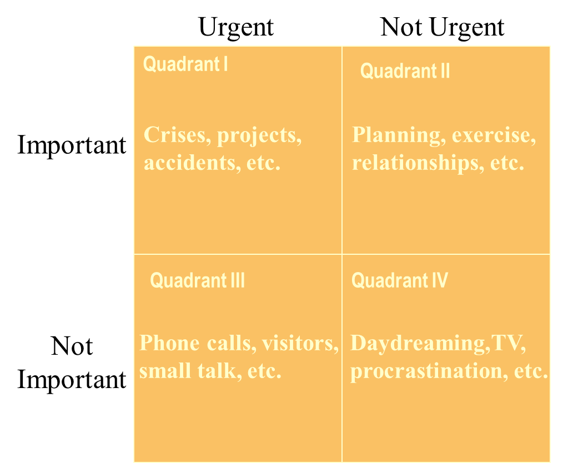
Self Activity1 – Prioritize Activities using the TM Matrix
Each of you write down your schedule as per the following activities
  Wake up and morning cleansing
  Exercise : Gym, yoga, pranayama
  Eating
  Studies in college
  Sports, Games
  Entertainment
  Studies at Home/ Hostel
  Sleep
  Social

Slide 20
Time Management Issues
Lack of planning
Incorrect priorities or goals
Time Waste - Ineffective use of time
Procrastination

Slide 21
Why do we procrastinate?
Don’t know where to start.
To avoid an unpleasant task.
We’re afraid to fail - perfectionism
Just do not want to do
Someone else will do it.

Slide 22
Procrastination Solutions
Start Something – Anything
  “In creating, the hardest part is to begin.”
  - Anonymous
Remember - You do not work best under pressure
Break it up
Make a list of things you’ve been meaning to do and start doing them
Learn to say “no” appropriately

Slide 23
Goal Setting
The difference between a Goal and a Dream is the written word
Goals are time bound
Goals provide clear focal points for action
Goals improve communication by promoting mutual agreement on expectation

Slide 24
Self Activity2 - Goal Setting
Set your Goals using the
rocks in the bucket story

Slide 25
Self Activity3 - Time Wasters
A time waster is anything that prohibits us from reaching our goals most effectively
How do you waste your time? - Activity

Slide 26
Self Activity4: Barriers to Learning
Barriers to Learning | How to overcome?

Slide 27
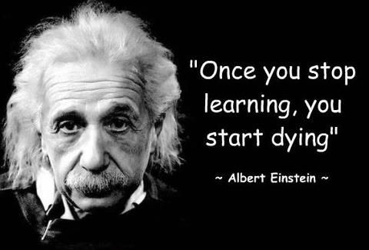
Life Long Learning

Slide 28


